Slide 1
POINTER AND DYNAMIC MEMORY IN C++

Slide 2
CONTENTs
Addresses in C++
Pointers
What are pointers?
Declaring Pointers
Assigning addresses to pointers
Getting the value of a variable using pointer
Changing values through Pointers
Pointer Initialization
Pointers and Array
Passing Pointer to Function
Pointer to Pointer
Void, Invalid and Null Pointers
Common mistakes when working with Pointers
Advantages of Pointers
Dynamic Memory Allocation
Operators new and new[]
Operators delete and delete[]
Dynamic Memory Allocation in C

Slide 3
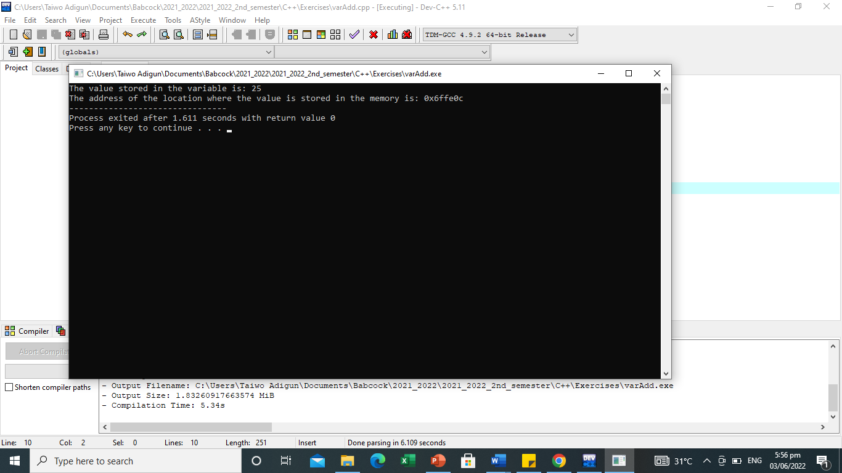
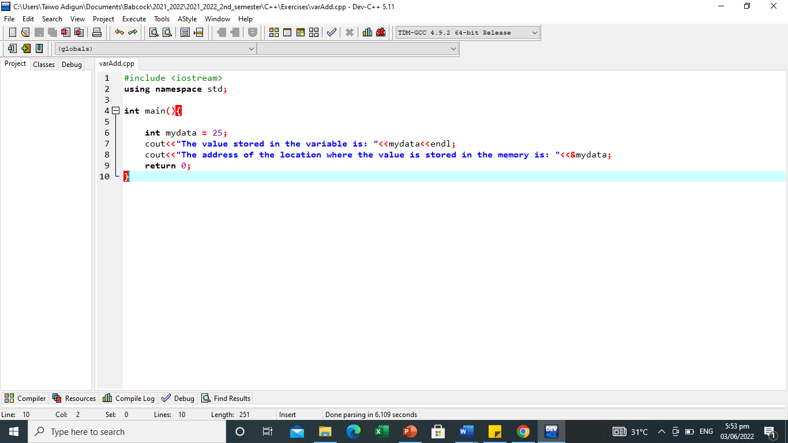
Addresses in C++
To understand the concept of pointer in C++, there is need to understand how computer stores data.
When a variable is created in C++ program, the variable is assigned a space in the computer memory with a unique address, and the value of this variable is stored in the assigned location.
C++ provides a means to know the address of memory cell where the data is stored and an opportunity to manipulate the value through the address instead of the variable name.
In Example I, mydata is a variable and &mydata returns the address(0x6ffe0c) of the variable.
Example I

Slide 4
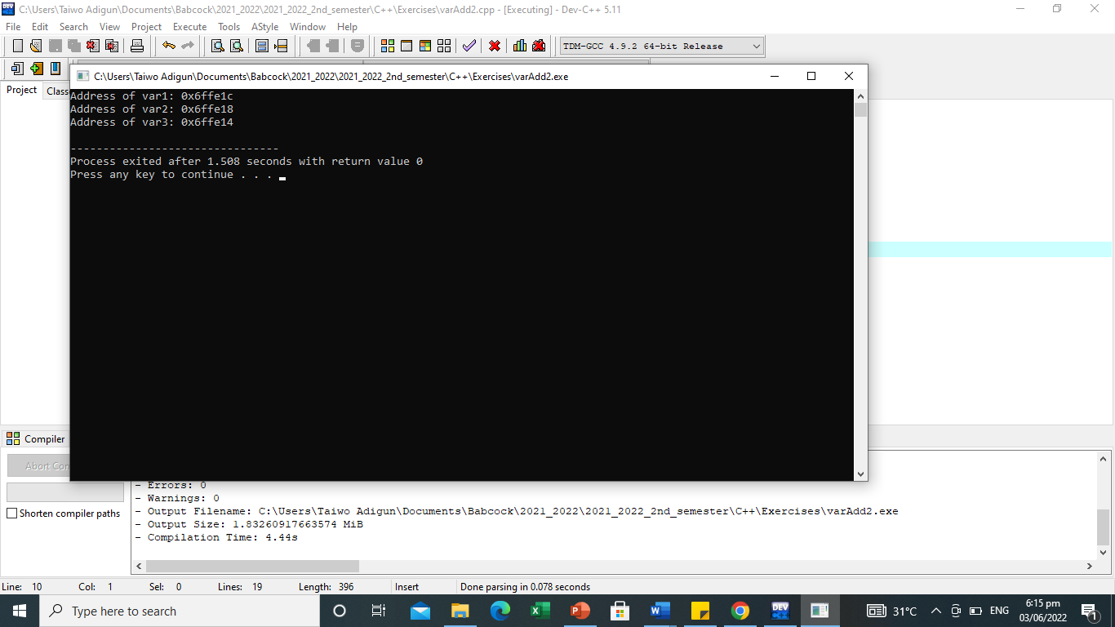
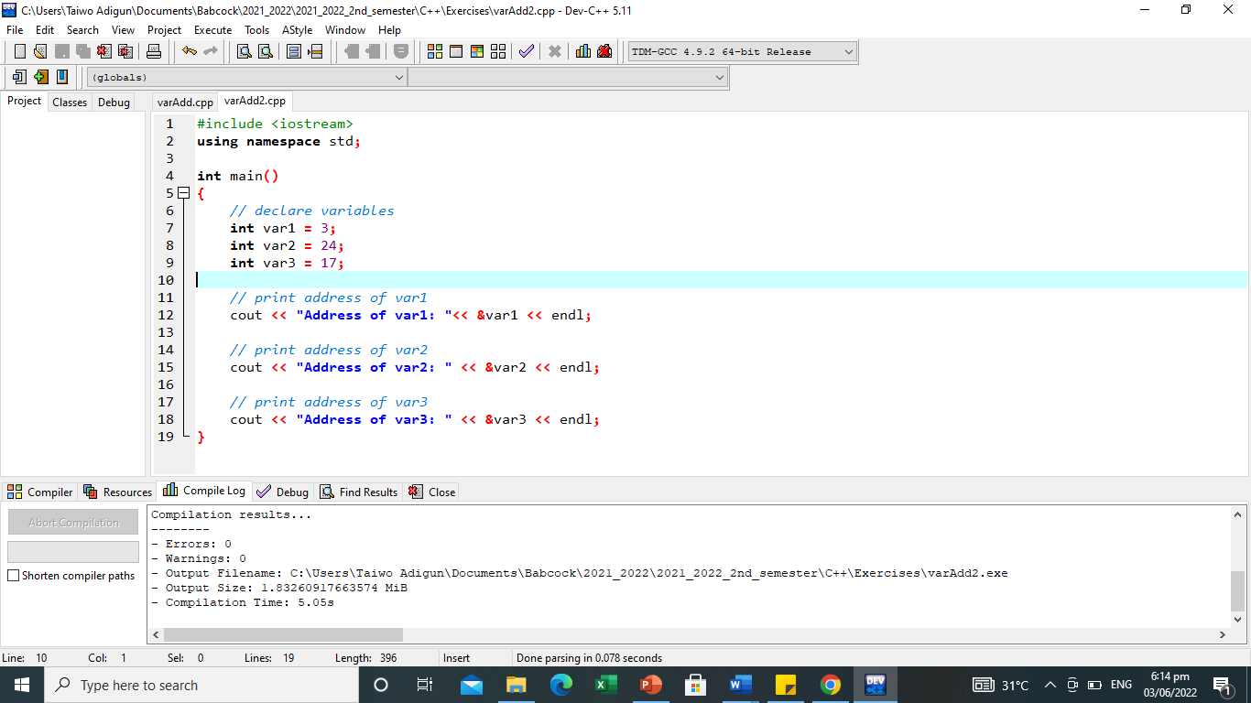
Addresses in C++
Example II
NOTE: When a variable is declared, the memory cell needed to store its value is assigned a specific memory address.
Generally, C++ programs do not actively decide the exact memory addresses of variables but the Operating System.
However, it may be useful for a program to be able to obtain the address of a variable during runtime in order to access data cells that are at a certain position relative to it.
Hence the need to store the addresses of variables.

Slide 5
Pointers
What are Pointers?
A pointer is simply a variable that holds the address of another variable.
It can also be described as a variable pointing to a specific address in a memory pointed by another variable. It is a symbolic representation of a memory address.
Like regular variables, pointers have data types. For example, a pointer of type integer can hold the address of a variable of type integer. A pointer of character type can hold the address of a variable of character type.

Slide 6
Pointers
Declaring Pointers
Pointers have been described to be variables, therefore they must be declared before use.
The declaration of C++ takes the following syntax:
datatype *variable_name; OR datatype* variable_name; OR datatype * variable_name;
The datatype is the base type of the pointer which must be a valid C++ data type.
The variable_name should be the name of the pointer variable.
It is the asterisk that marks the variable as a pointer.
Below are examples of valid pointer declarations in C++:
int *pAge; // a pointer to integer double *pArea; // a pointer to double
float *pointPI; // a pointer to float char *pSex // a pointer to a character

Slide 7
Pointers
Assigning addresses to pointers
Since pointers hold addresses of other variables, such addresses must be assigned to the pointer variables.
The address of a variable can be obtained by preceding the name of a variable with an ampersand sign (&).
The reference operator(&) also known as address-of operator returns the variable’s address.
int var; //variable declaration
var = 5;
int* pointVar; //pointer declaration
pointVar = &var; // assign address of var to pointVar pointer
Here, 5 is assigned to the variable var. And, the address of var is assigned to pointVar pointer with the statement pointVar = &var
var
5
1706
1707
1708
pointVar
1707
3002
3003
3004
3005
3006

Slide 8
Pointers
Getting the value of a variable using pointer
Values held by variables could be accessed through the variables that store their respective addresses.
This is done by preceding the pointer name with the dereference operator (*).
int* pointVar, var; //variable and pointer declaration
var = 5;
pointVar = &var; //assign address of var to pointVar
cout << *pointVar << endl; // access value pointed by pointVar

Slide 9
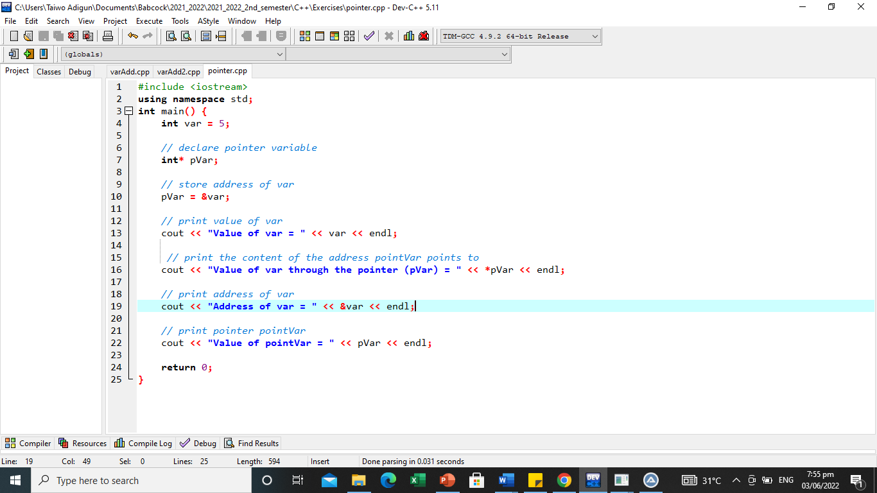
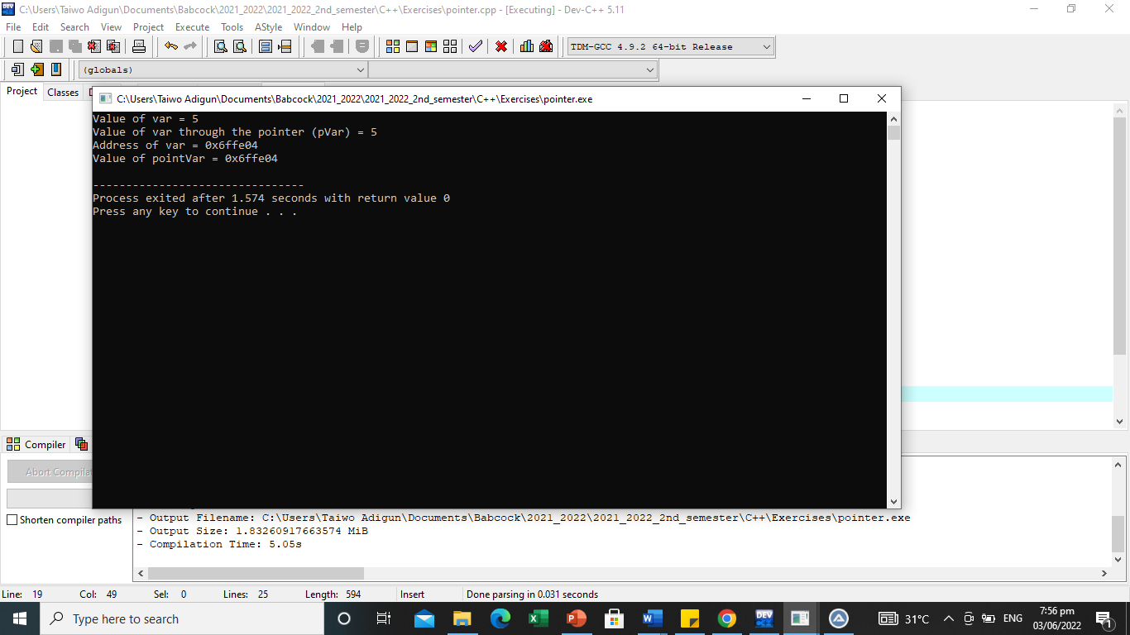
Pointers

Slide 10
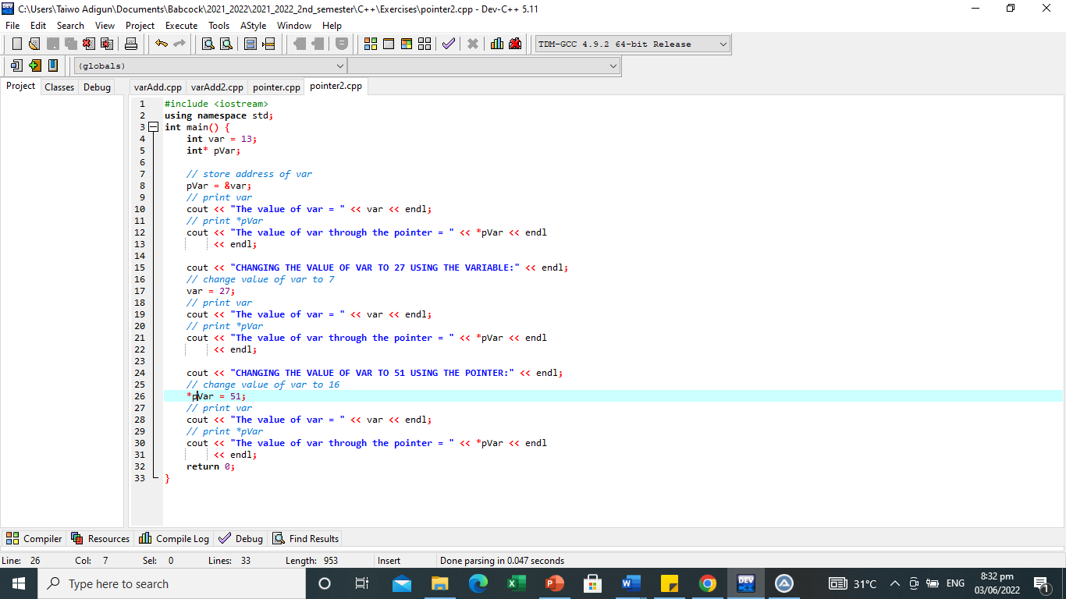
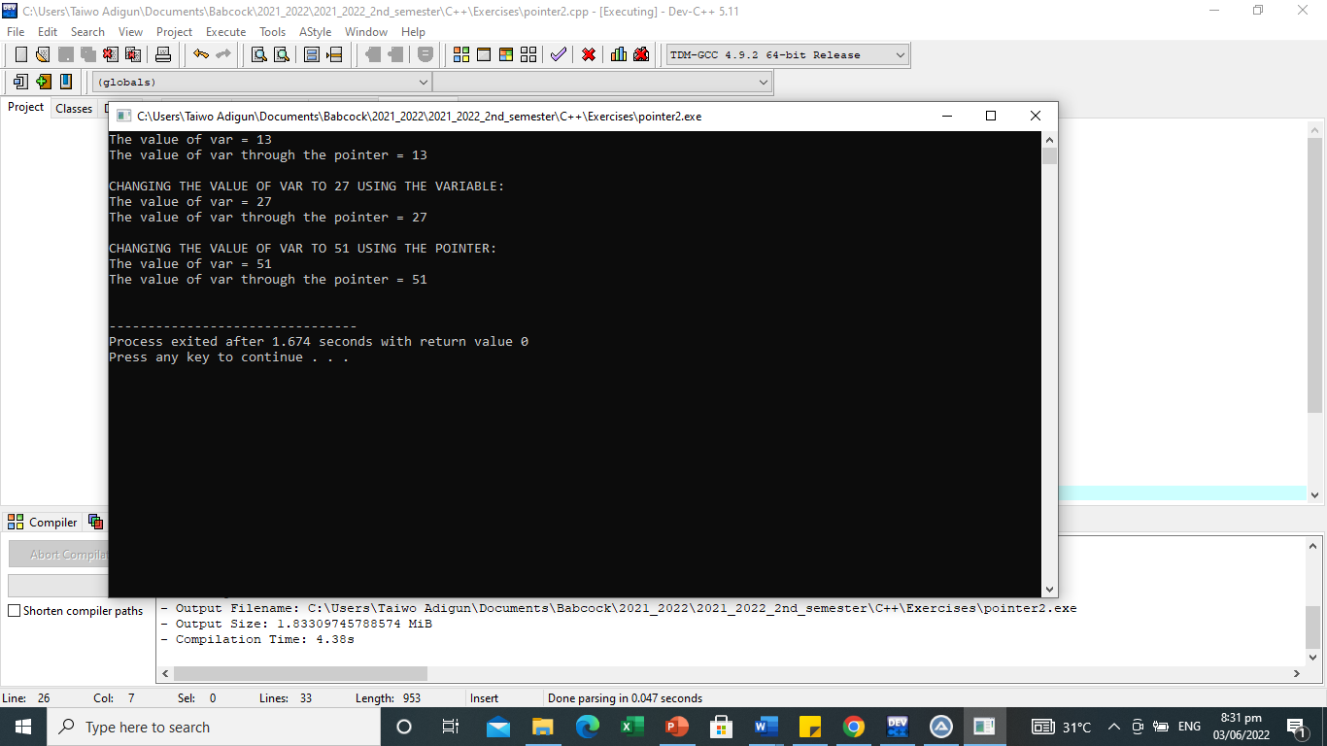
Pointers
Changing values through Pointers
Since a pointer variable points to the address of a particular variable, C++ provides a means of updating the value of such a variable through the pointer variable.
If pVar points to the address of var, we can change the value of var by using *pVar.

Slide 11
Pointers
Pointer Initialization
Pointers as a variable can also be initialized at the point of declaration just like regular variables.
That is, Pointers can be initialized to point to specific locations at the very moment they are defined.
int myvar;
int * myptr = &myvar;
same as:
int myvar;
int * myptr;
myptr = &myvar;

Slide 12
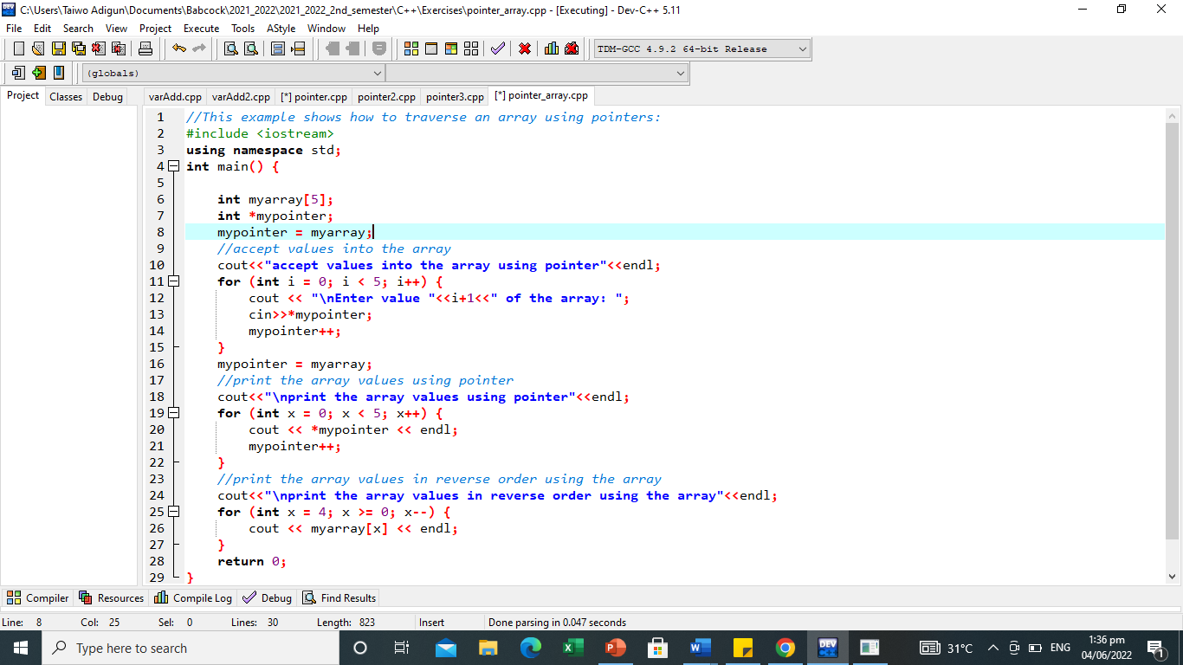
Pointers and Array
The concept of arrays is related to that of pointers.
The array name itself denotes the base address of the array, that is, arrays work very much like pointers to their first elements.
This means that ampersand (&) is not needed to assign the address of an array to a pointer.
For example:
int myarray [20];
int * mypointer;
mypointer = myarray;
After the above declaration, mypointer and myarray will be equivalent, and they will share the same properties. However, a different address can be assigned to mypointer, but we cannot assign anything to myarray.
mypointer = &myarray; //invalid

Slide 13
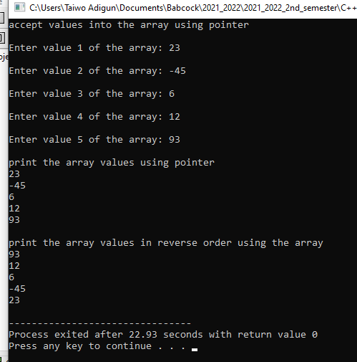
Pointers and Array

Slide 14
Passing Pointers to Functions
C++ allows you to pass a pointer to a function just as values are used.
Functions can also accept an array declared as a pointer.
Function call by pointer is a method of passing arguments to a function that copies the address of an argument into the formal parameter.
Inside the function, the address is used to access the actual argument used in the call.
This makes the changes made to the parameter to affect the passed argument: function call by reference

Slide 15
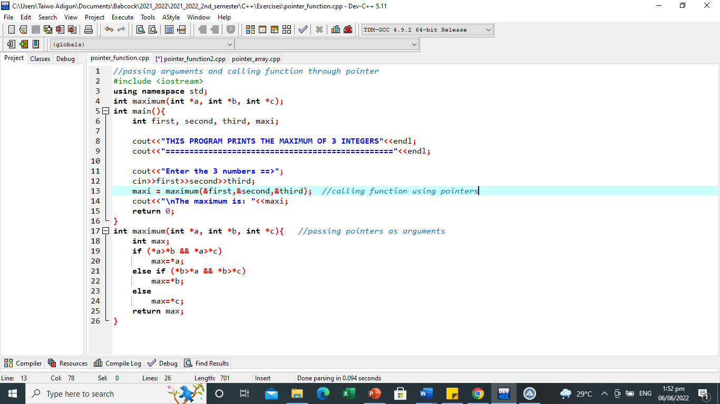
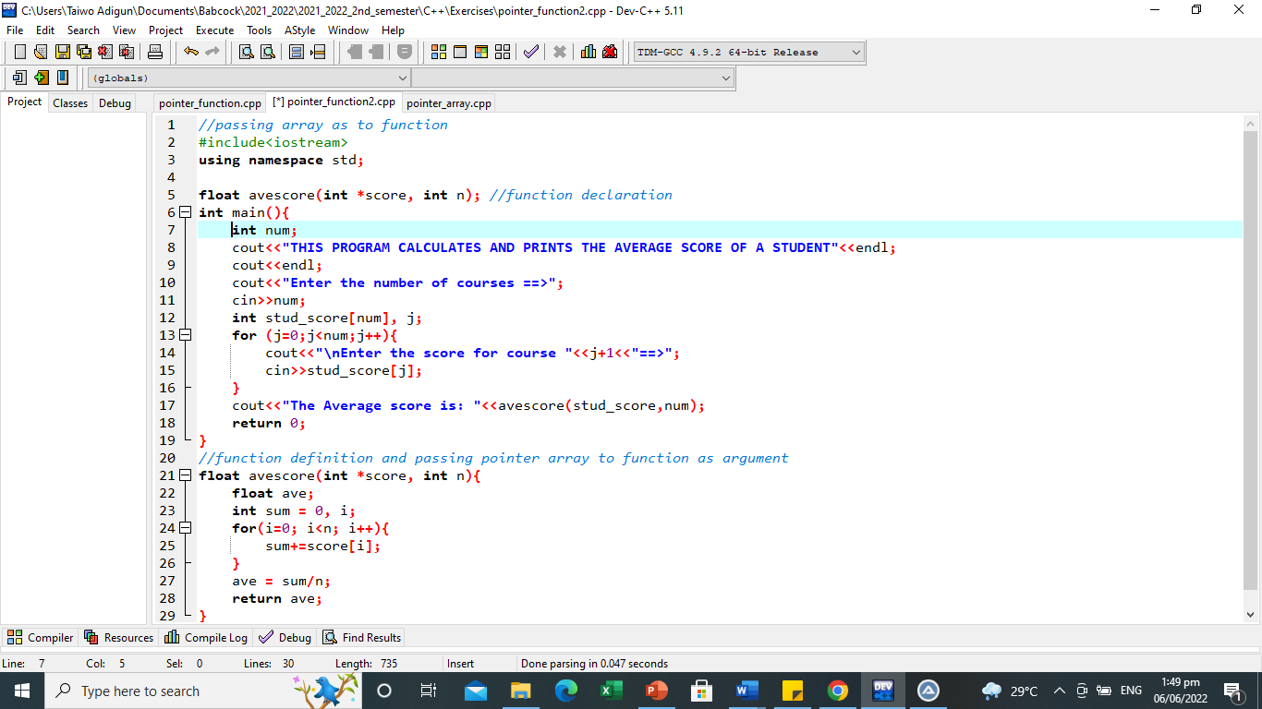
Passing Pointers to Functions
Example I
Example II

Slide 16
Pointer to Pointer
C++ allows the use of pointers that point to pointers, which, in turn, point to data (or even to other pointers).
The syntax simply requires an asterisk (*) for each level of indirection in the declaration of the pointer.
int mydata = 45;
int *mypoint1;
int **mypoint2;
mypoint1 = &mydata;
mypoint2 = &mypoint1;
Assuming the random chosen memory locations
for each variable are 7309, 7507 and 7600. The allocation could be represented as:
mydata
mypoint1
mypoint2
45
7309
7507
7309
7507
7600

Slide 17
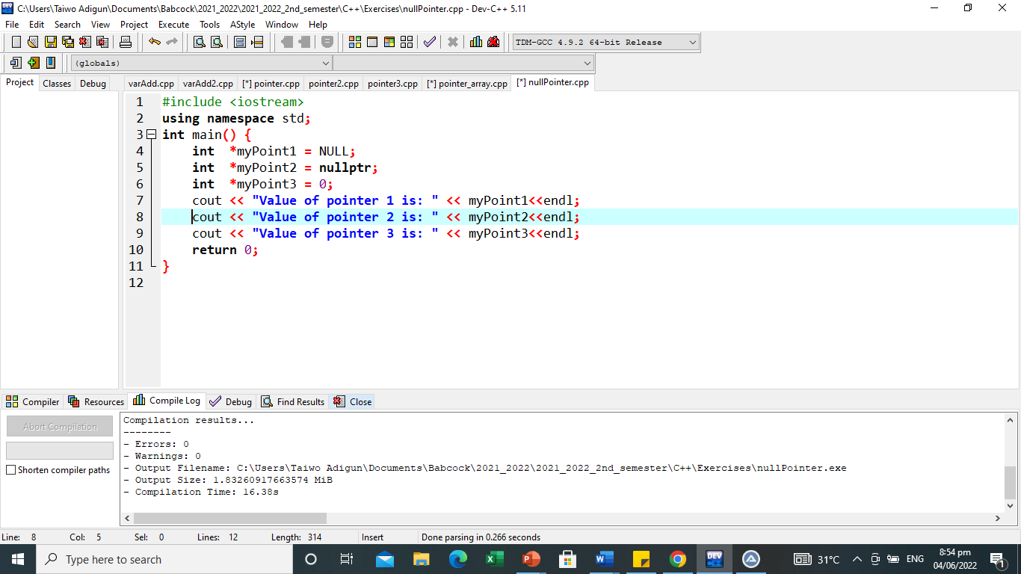
Null Pointers
In C++, pointers are allowed to take any address value, no matter whether there is something at that address or not.
Accessing such a pointer causes undefined behaviour, ranging from an error during runtime to accessing some random value.
If there is no exact address that is to be assigned, that is, a pointer really needs to explicitly point to nowhere; then the pointer variable can be assigned a NULL, nullptr or 0(zero).
It should be done during the declaration.
Such a pointer is known as a null pointer.
Its value is zero and is defined in many standard libraries like iostream.
The 3 pointer variables are null pointers, meaning that they explicitly point to nowhere, and they both actually compare equal.

Slide 18
NULL POINTER
Present in some libraries such as:
iostream
To use it, it must be declared and initialize
int *pointer=NULL;
int *pointer=0;
int *pointer=nullptr;
Note: it is best initialize with NULL because some operating systems reserved 0 memory address
Note to initialize pointer to nullptr, some earlier version of CPP may throw the following error:
‘nullptr' was not declared in scope
SOLUTION:
from tools to compile option
to settings to code generation
to language standard(-std) from
drop down menu pick iso c++11

Slide 19
NULL POINTER
Null pointer is a macro constant defined in some libraries or header files such as
<iostream>
<cstring>
<clocale>
<ctime>
<cwchar>
<cstddef>

Slide 20
Common mistakes when working with pointers
Suppose we want a pointer myPoint to point to the address of variable myVar
i.e
int myVar, *myPoint;
Wrong
myPoint = myVar;
// myPoint is an address but myVar is not
*myPoint = &myVar;
// &myVar is an address
// *myPoint is the value stored in &myVar
Correct
myPoint = &myVar;
// myPoint is an address and so is &myVar
*myPoint = myVar;
// both *myPoint and myVar are values

Slide 21
Advantages of using Pointers
Pointers are variables which store the address of other variables in C++.
More than one variable can be modified and returned by function using pointers.
Memory can be dynamically allocated and de-allocated using pointers.
Pointers help in simplifying the complexity of the program.
The execution speed of a program improves by using pointers.

Slide 22
Dynamic memory allocation

Slide 23
Dynamic memory allocation
In our previous programs, all memory needs were determined before program execution by defining the variables needed.
Many times, the programmer is not aware in advance how much memory will be needed to store a particular information. For example, when the memory needed depends on user input.
On these cases, programs need to dynamically allocate memory during program execution, that is a program can allocate and release memory dynamically in line with current memory requirements. .
C++ provides new and delete operators to achieve this.
Memory is allocated at run time within the heap for the variable of a given type new operator.
delete operator de-allocates memory that was previously allocated by new operator if the dynamically allocated memory in not in need anymore.

Slide 24
Operators new and new[]
new operator is usually used to allocate memory to a null pointer by following it with a type specifier. The syntax is:
pointer = new type
pointer = new type [number_of_elements]
i.e:
int *mypoint; OR int *mypoint = NULL;
mypoint = new int; //allocates memory to contain one single element of type int
mypoint = new int [5]; //allocates a block (an array) of 5 elements of type int
Here, mypoint is a pointer, and thus, the first element pointed to by mypoint can be accessed either with the expression mypoint[0] or the expression *mypoint (both are equivalent). The second element can be accessed either with mypoint[1] or *(mypoint +1), and so on...

Slide 25
Operators new and new[] – Exception Handling
The dynamic memory requested by our program is allocated by the system from the memory heap. However, computer memory can also be exhausted. Therefore, there are no guarantees that all requests to allocate memory using operator new are going to be granted by the system.
C++ provides two standard mechanisms to check if the allocation was successful.
A default exception of type bad_alloc is thrown when the allocation fails, if the basic syntax is used and the program is terminated. i.e
mypoint = new int [5]; // if allocation fails, bad_alloc exception is thrown
ii. Handling the exception by specific handler known as nothrow. When it is used and a memory allocation fails, instead of throwing a bad_alloc exception or terminating the program, the pointer returned by new is a null pointer, and the program continues its execution normally., nothrow is declared in header <new> and as argument for new:
mypoint = new (nothrow) int [5];

Slide 26
Operators delete and delete[]
In most cases, memory allocated dynamically is only needed during specific periods of time within a program.
Once it is no longer needed, it can be freed so that the memory becomes available again for other requests of dynamic memory.
The syntax is:
delete pointer;
delete[] pointer;
i.e
delete mypoint;
delete [] mypoint;
The first statement releases the memory of a single element allocated using new, and the second one releases the memory allocated for arrays of elements using new and a size in brackets ([]).

Slide 27
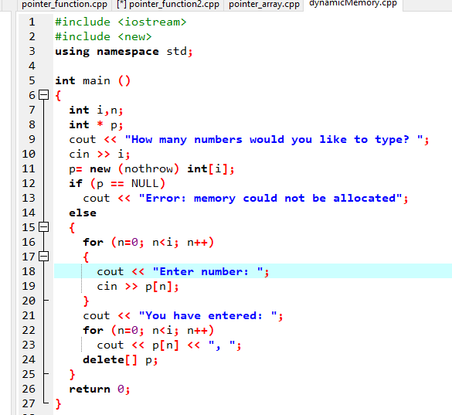
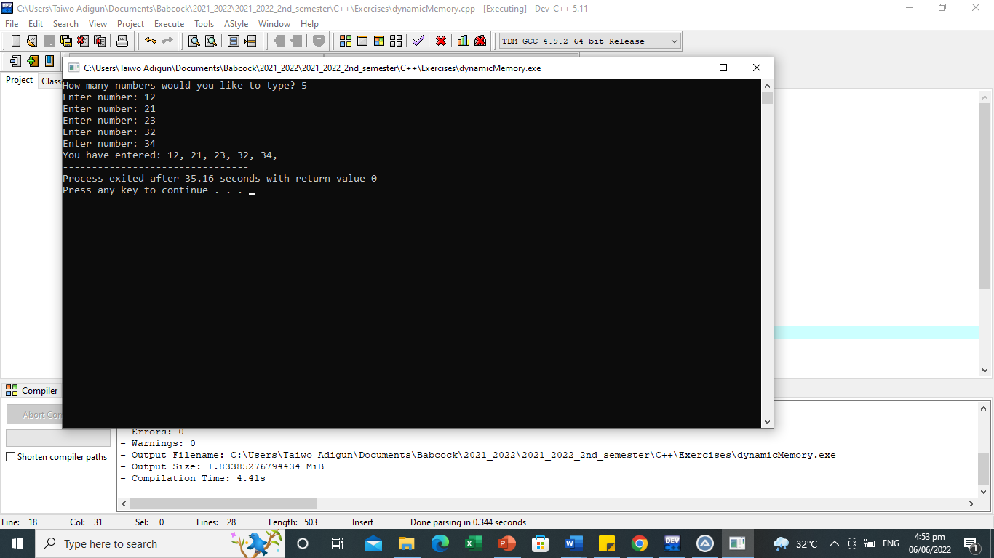
Dynamic Memory Allocation in C

Slide 28
THANK YOU

